Slide 1
Naïve Bayes Classifier

Slide 2
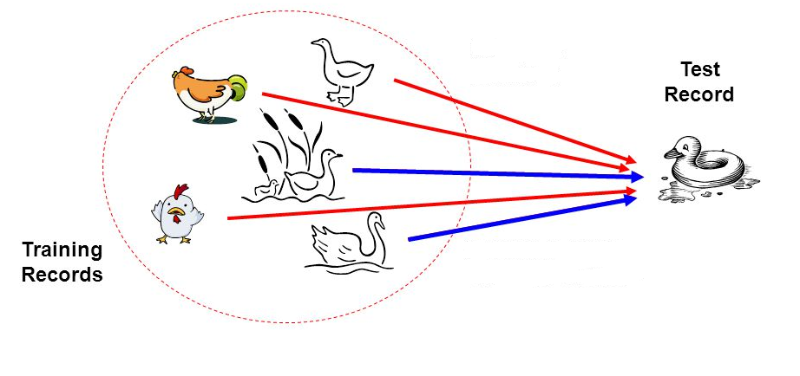
Principle
If it walks like a duck, quacks like a duck, then it is probably a duck

Slide 3
Naïve Bayes Classifier
Supervised learning algorithm used for classification
Based on Bayes algorithm
Bayes theorem
4. Posterior probability
3. Likelihood
1. Prior probability
P(A) Prior Probability : Probability of event A before event B
P(A|B) Posterior Probability : Probability of event A after event B is true
P(A|B) = P ( B | A) * P (A)
P(B)
2. Marginal Likelihood
Notes:
Posterior probability is the probability an event will happen after all evidence or background information has been taken into account.
It is closely related to prior probability, which is the probability an event will happen before you taken any new evidence into account.
You can think of posterior probability as an adjustment on prior probability:
Posterior probability = prior probability + new evidence (called likelihood).
For example, historical data suggests that around 90% of students who start college will graduate within 4 years. This is the prior probability.
However, you think that figure is actually lower, so set out to collect new data. The evidence you collect suggests that the true figure is actually closer to 80%; This is the posterior probability.

Slide 4
Origin of the Terms
The words posterior and prior come from the latin a priori. The definition of “a priori” is:
“…relating to what can be known through an understanding of how certain things work [i.e. a hypothesis] rather than by observation” ~ Miriam Webster.
The opposite of “a priori” is a posteriori, which is defined as:
“… relating to what can be known by observation rather than through an understanding of how certain things work” ~ Miriam Webster.

Slide 5
Two terms that students often confuse in statistics are likelihood and probability. Here’s the difference in a nutshell: Probability refers to the chance that a particular outcome occurs based on the values of parameters in a model. Likelihood refers to how well a sample provides support for particular values of a parameter in a model. When calculating the probability of some outcome, we assume the parameters in a model are trustworthy. However, when we calculate likelihood we’re trying to determine if we can trust the parameters in a model based on the sample data that we’ve observed.
likelihood and probability

Slide 6
Example
Dataset : [Document]
>> Classify : “ A very close game”
Text | Category
“A great game” | Sports
“The Election was over” | Non Sports
“Very clean Match” | Sports
“ A clean but forgettable game” | Sports
“It was a close election” | Non Sports
Total words in Sports : 11
Total words in non Sports : 09
Total unique words : 14

Slide 7
P (Sports | “ A very close game”) = ?
P (Non Sports | “ A very close game”) = ?
How find a probability?
“ A very close game”
P (“ A very close game”) = P(A) * P(very) * P(close) * P(game)
P (“ A very close game”|Sports) = P(A | Sports) * P(very | Sports) * P(close | Sports) * P(game | Sports)
P (“ A very close game”|Non Sports) = P(A | Non Sports) * P(very | Non Sports) * P(close | Non Sports)
* P(game | Non Sports)
Feature engineering

Slide 8
Calculating Probabilities
“ A very close game”
P(A | Sports) = 2/11
P(very | Sports) = 1/11
P(close | Sports) = 0/11
P(game | Sports) = 2/11
P(A | Sports) * P(very | Sports) * P(close | Sports) * P(game | Sports) = 0
Solution : Laplace Smoothing
word count + 1
P(word) = ----------------------------------------------------
total no of words + no of unique words

Slide 9
Text | Category
“A great game” | Sports
“The Election was over” | Non Sports
“Very clean Match” | Sports
“ A clean but forgettable game” | Sports
“It was a close election” | Non Sports
0+1
P(close | Sports) = --------
11+14
2+1
P(A | Sports) = -----------
11+14
Total words in Sports : 11
Total words in non Sports : 09
Total unique words : 14
Word | P (word | Sports) | P (word | Non Sports)
A | 2+1 / 11+14 = 0.12 | 1 +1 / 9+14 = 0.08
very | 1+1 / 11+14 = 0.08 | 0+1 / 9+14 = 0.04
Close | 0 +1 / 11+14 = 0.04 | 1+1 / 9+14 = 0.08
Game | 2+1 / 11+14 = 0.12 | 0+1 / 9+14 = 0.04
 | 0.12*0.08*0.04*0.12 = 4.608 *10^-5 | 0.08*0.04*0.08*0.04 = 1.024*10^-5

Slide 10
Naïve Bays Classifier
Family of simple "probabilistic classifiers”
Based on applying Bayes' theorem
Prediction of membership probabilities is made for every class such as the probability of data points associated to a particular class.
The class having maximum probability is appraised as the most suitable class.

Slide 11
Naïve Bays Classifier
Advantage - requires a small number of training data to estimate the
parameters necessary for classification
NB classifiers conclude that all the variables or features are not related to each other.

Slide 12
Naïve Bays Classifier
Advantage - requires a small number of training data to estimate the
parameters necessary for classification
NB classifiers conclude that all the variables or features are not related to each other.

Slide 13
Naïve Bays Classifier
The Existence or absence of a variable does not impact the existence or absence of any other variable.
Example:
Fruit may be observed to be an apple if it is red, round, and about 4″ in diameter.
In this case also even if all the features are interrelated to each other, and NB classifier will observe all of these independently contributing to the probability that the fruit is an apple.

Slide 14
Applications of Naïve Bays Classifier
Real-time Prediction: Being a fast learning algorithm can be used to make predictions in real-time as well.
Multi Class Classification: problems also.
It can be used for multi-class classification
Text Classification: As it has shown good results in predicting multi-class classification so it has more success rates compared to all other algorithms. As a result, it is majorly used in sentiment analysis & spam detection.

Slide 15



Naïve Bays Classifier

Slide 16






























































































Naïve Bays Classifier…

Slide 17












Naïve Bays Classifier…
What's the probability that M2 produces defective solar cell ?
Defective Solar cell
Machine 2

Slide 18
Naïve Bays Classifier…
Bayes theorem
4. Posterior probability
3. Likelihood
1. Prior probability
P(A|X) = P ( X | A) * P (A)
P(X)
2. Marginal Likelihood

Slide 19
Naïve Bays Classifier…
Machine 1 : 30 solar cells / hr Machine 2: 20 solar cells / hr
Out of all parts 1% are defective
Out of all defective parts 50% from M1
50% from M2
Question:
What's the probability that a solar cell produced from M2 is defective

Slide 20
Naïve Bays Classifier…
P(M1) = 30/50 = 0.6 P(M2) = 20/50= 0.4
P(defective) = 1%
P(M1|Defect) = 50%
P(M2|Defect) = 50%
Question:
P( defect | Machine 2 ) = ?
P(A|X) = P ( X | A) * P (A)
P(X)

Slide 21
Naïve Bays Classifier…
P(M2) = 20/50= 0.4
P(defective) = 1%
P(M2|Defect) = 50% Question: P(defect|M2) = ?

Slide 22
Naïve Bays Classifier…
P(Defect | M2) = P(M2 | defect) * P(defect)
P(M2)
P(Defect | M2) = 0.5 * 0.01
0.4
= 0.0125 = 1.25%
4. Posterior probability
3. Likelihood
1. Prior probability
P(A|X) = P ( X | A) * P (A)
P(X)
2. Marginal Likelihood

Slide 23
Naïve Bays Classifier…
Summary with Example:
1000 solar cells
400 from Machine 2
Defective 10
5 defective from Machine 2
% defective from Machine 2 = 5/400=0.0125=1.25%

Slide 24
Naïve Bays Classifier…
Another Example:
A doctor knows that Cold causes fever 50% of the time
If a patient has fever, what’s the probability he/she has cold?

Slide 25
Naïve Bays Classifier…
Another Example…
Assume …
Prior probability of any patient having cold is 1/30,000
Prior probability of any patient having fever is 1/60

Slide 26
Naïve Bays Classifier…
Another Example…
If a patient has fever, the Probability of having he/she has cold is
Likelihood
Prior probability
P( C | F ) = P (F | C) P (C)
P(F)
Marginal Likelihood

Slide 27
Naïve Bays Classifier…
Another Example…
If a patient has fever, the Probability of having he/she has cold is
Likelihood
= 0.5
Prior probability
P( C | F )
X (1/30,000)
= 0.001
1 / 60
Marginal Likelihood

Slide 28
Naïve Bays Classifier Python Code
import numpy as np import pandas as pd import seaborn as sns sns.set(color_codes=True)
import matplotlib.pyplot as plt
%matplotlib inline
from sklearn.preprocessing import StandardScaler
from sklearn.model_selection import train_test_split from sklearn.naive_bayes import GaussianNB
from sklearn import metrics
colnames = ['preg', 'plas', 'pres', 'skin', 'test', 'mass', 'pedi', 'age', 'class'] pima_df = pd.read_csv("pima-indians-diabetes.data", names= colnames)
X = data.drop(Outcome”, axis = 1) Y = data[ [“outcome”] ]
X_train, X_test, Y_train, Y_test = train_test_split(X,Y, test_size= 0.2, random_state = 1)
model = GaussianNB() model.fit(X_train, Y_train) Y_pred = model.predict(X_test)

Slide 29
Naïve Bays Classifier Python Code
STEPS-
Initially, all the necessary libraries are imported like numpy, pandas, train-test_split, GaussianNB, metrics.
Since it is a data file with no header, we will supply the column names that have been obtained from the above URL
Created a python list of column names called "names".
Initialized predictor variables and the target that is X and Y respectively.
Transformed the data using StandardScaler.
Split the data into training and test sets.
Created an object for GaussianNB.
Fitted the data in the model to train it.
Made predictions on the test set and stored it in a ‘predictor’ variable.

Slide 30
Naïve Bays Classifier Python Code
from sklearn import metrics
# make predictions
predicted = model.predict(X_test)
from sklearn.metrics import accuracy_score, confusion_matrix metrics.confusion_matrix(predicted, y_test)

Slide 31
Naïve Bays Classifier Python Code
## Calculate the model_score of the testing data to know how good is the model performing in generalizing the two classes
model_score = model.score(X_test, y_test) model_score

Slide 32
Naïve Bays Classifier Python Code
##Evaluation of the model
y_predictProb = model.predict_proba(X_test) from sklearn.metrics import auc, roc_curve
fpr, tpr, thresholds = roc_curve(y_test, y_predictProb[::,1]) roc_auc = auc(fpr, tpr)
roc_auc
plt.plot(fpr, tpr, color='darkorange', label='ROC curve (area = %0.2f)' % roc_auc) plt.plot([0, 1], [0, 1], color='navy', linestyle='--')
plt.xlabel('False Positive Rate') plt.ylabel('True Positive Rate') plt.title('Receiver operating characteristic') plt.legend(loc="lower right")

Slide 33
Thank You !!!

